Slide 1

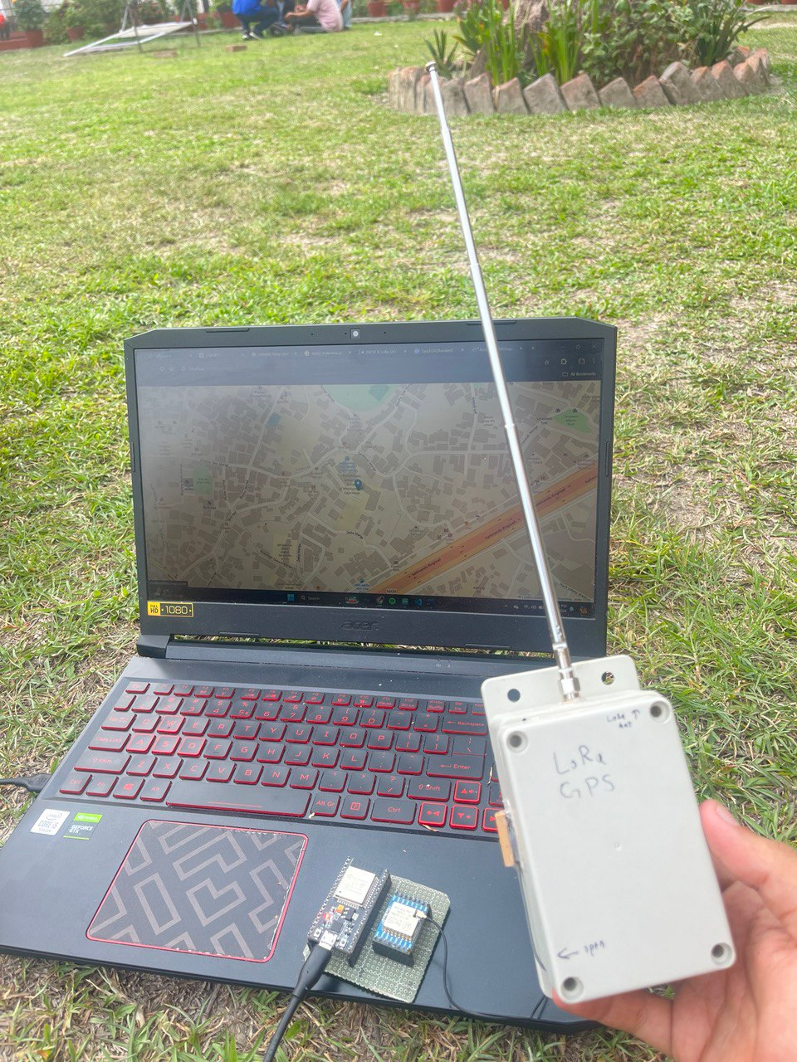
LORA GPS TRACKER
TEAM
UNITED TECH CLUB
UNITED TECHNICAL COLLEGE

Slide 2

1
About Project & Product View
2
Vision & Mission
3
Uses of this product
4
Market Analysis
5
Technology Used
LORA GPS TRACKER

Slide 3
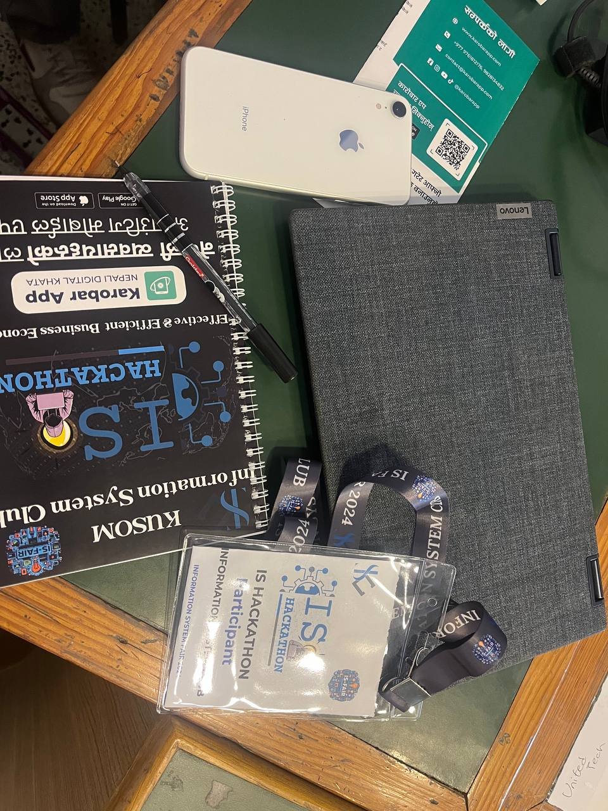
LORA GPS TRACKER
INTRODUCTION
Efficient and Reliable Tracking: Designed for diverse applications.
Can be used from anywhere
Overcomes limitations of cellular and satellite tracking technologies.
CEO OF TIMMERMAN INDUSTRIES

Slide 4
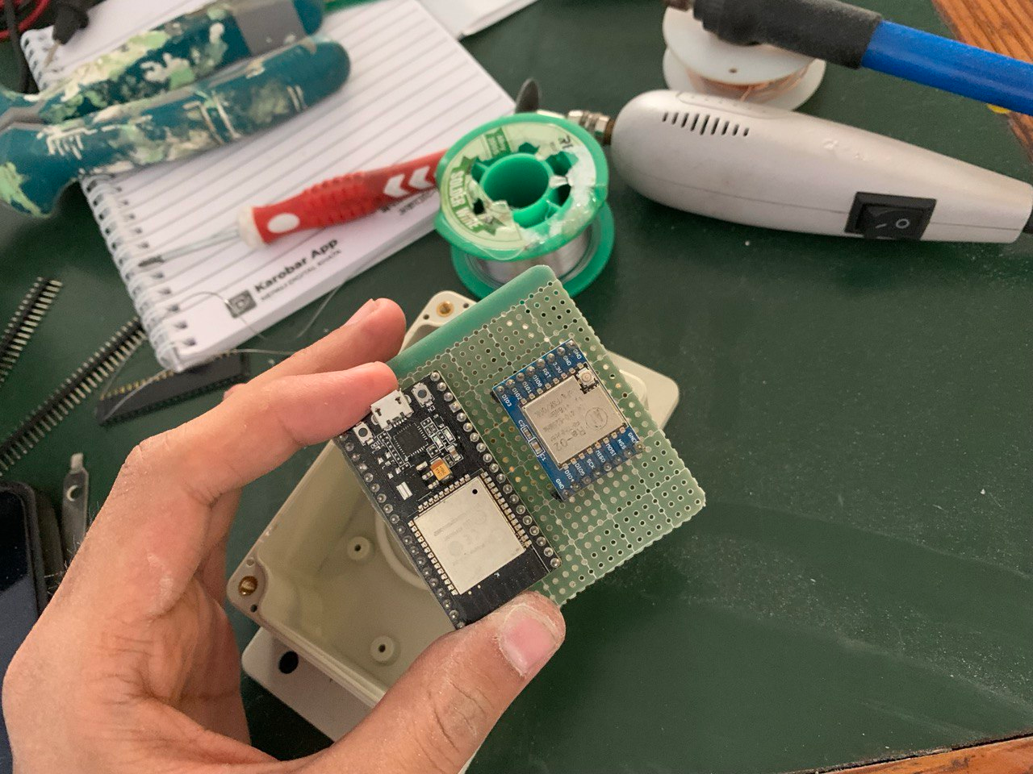
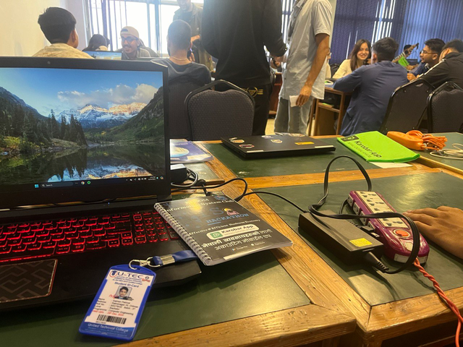
LORA GPS TRACKER
VISION
LORA GPS Tracker was made to achieve the following vision
SUITABILITY FOR REMOTE AND CHALLENGING ENVIRONMENTS.
ROBUST, COST-EFFECTIVE, AND SCALABLE TRACKING SOLUTION.
ENHANCE OPERATIONAL EFFICIENCY AND REAL-TIME DATA ACCESS.
SURPASS LIMITATIONS OF CELLULAR AND SATELLITE TRACKING TECHNOLOGIES.

Slide 5

LORA GPS TRACKER
USE SECTOR OF
LORA BASED TRACKER
1
2
WILDLIFE TRACKING
ASSEST TRACKING
4
3
RESCUE OPERATION
PERSONAL SECURITY

Slide 6
LORA GPS TRACKER
SOME USES OF THIS PRODUCT
1
2
3
4
WILD LIFE
WILD LIFE
SECURITY
ASSEST MANAGEMENT
Real-time tracking of animals.
Supports conservation efforts and behavioral studies
Enhances personal and asset security.
Tracks and manages valuable assets
5
6
7
8
SECURITY
TRANSPORT LOGISTICS
DISASTER RESCUE
DISASTER RESCUE
Reduces risk of loss or theft.
Provides real-time tracking of vehicles and cargo.
Facilitates location and rescue in disaster-stricken areas
Useful where conventional communication systems fail.

Slide 7
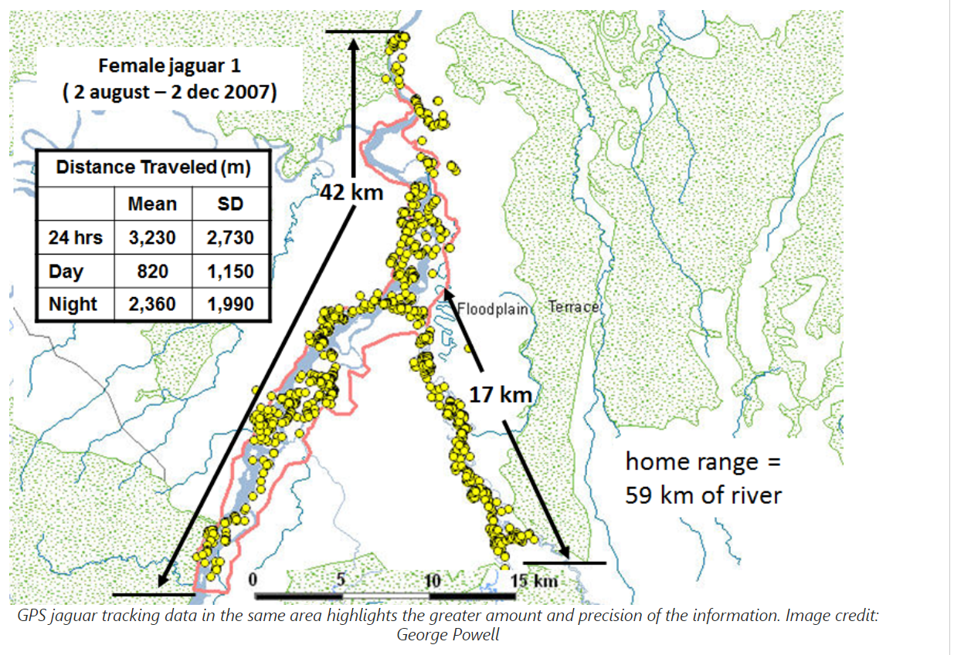
LORA GPS TRACKER
ONE USE EXAMPLE

Slide 8

LORA GPS TRACKER
Market
Analysis

Slide 9
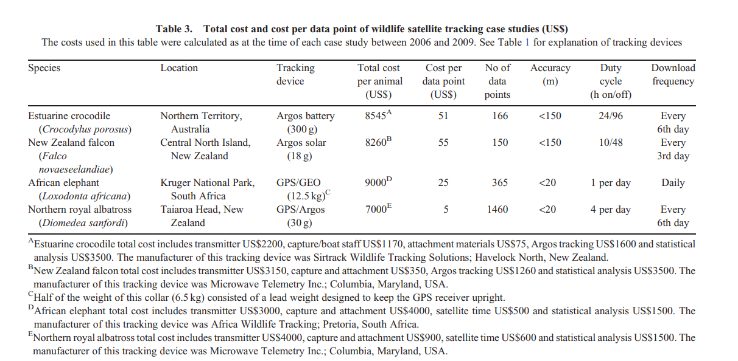
LORA GPS TRACKER
Ref: http://dx.doi.org/10.1071/WR10211

Slide 10
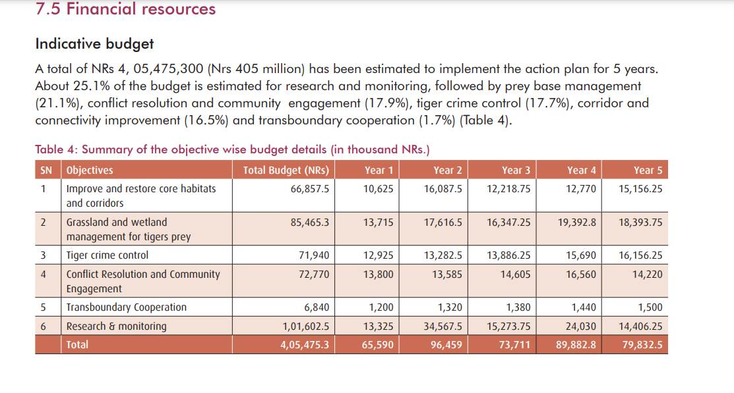
LORA GPS TRACKER
Ref: https://dnpwc.gov.np/media/publication/Tiger_Conservation_Action_Plan_2016-2020.pdf
4 ARAB 😲😳

Slide 11
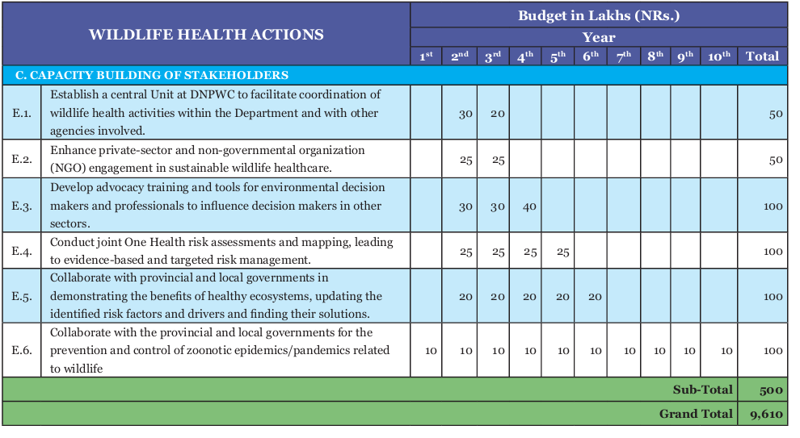
LORA GPS TRACKER
Wild-Life Act 2023-2034

Slide 12
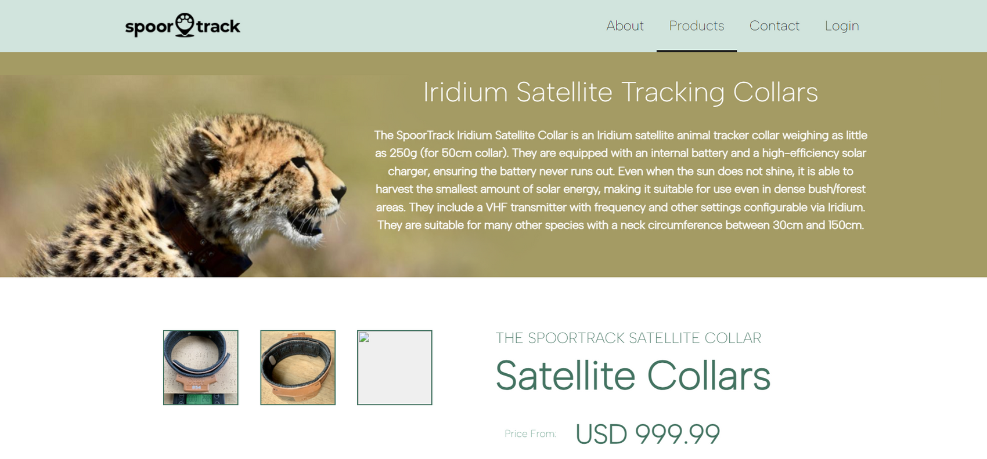

LORA GPS TRACKER

Slide 13
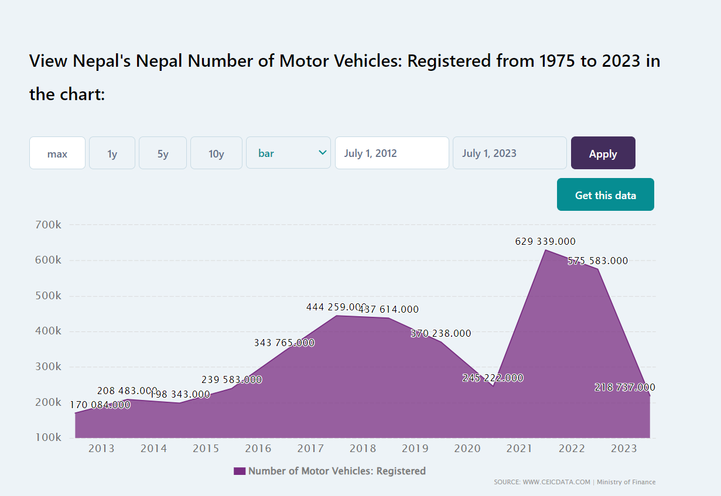
LORA GPS TRACKER

Slide 14
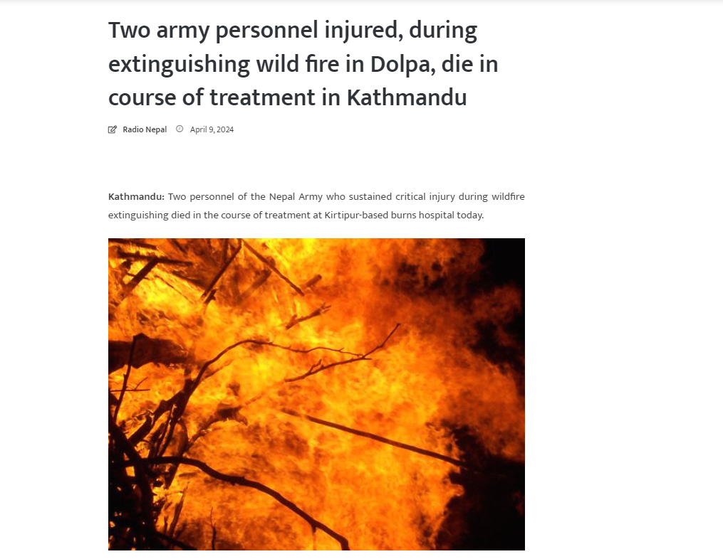
LORA GPS TRACKER

Slide 15
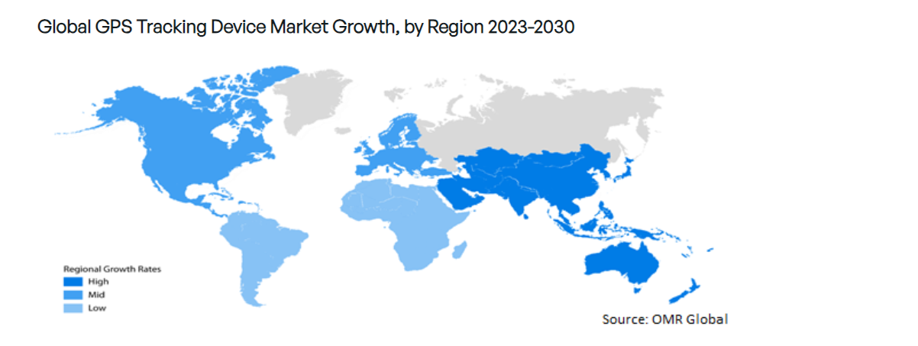
LORA GPS TRACKER

Slide 16

LORA GPS TRACKER
OUR PRODUCT CAN BE MADE ONLY IN NRs. 15k-20k
BIG CHANCE
ALERT!

Slide 17





LORA GPS TRACKER
TECHNOLOGY USED
ESP 32 /64

Slide 18
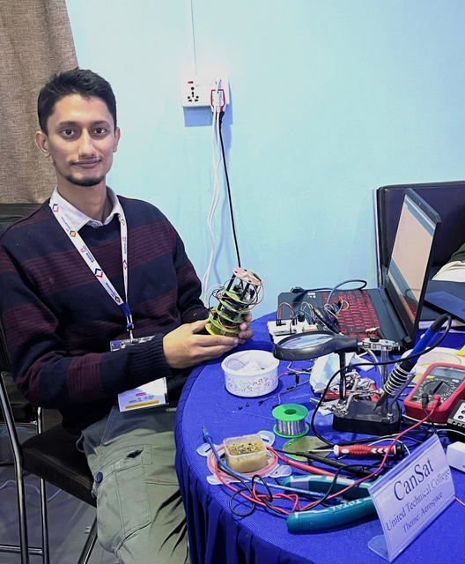
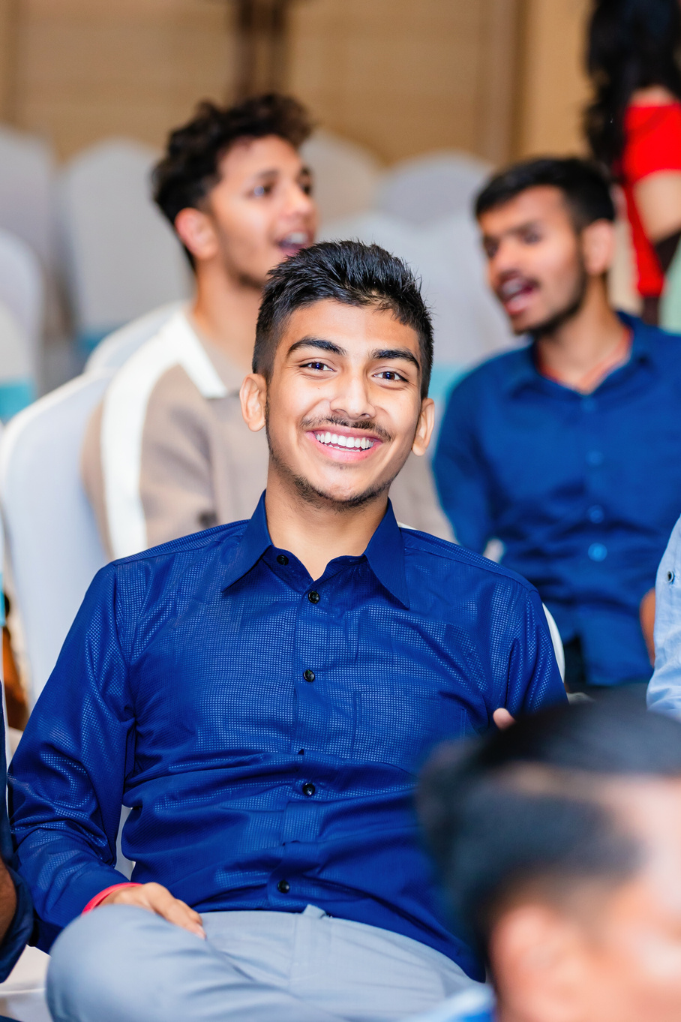
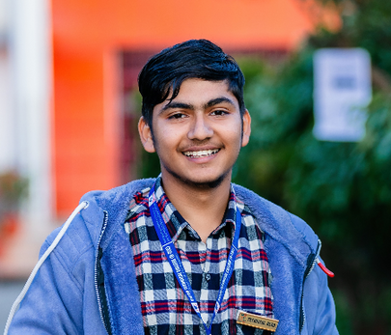
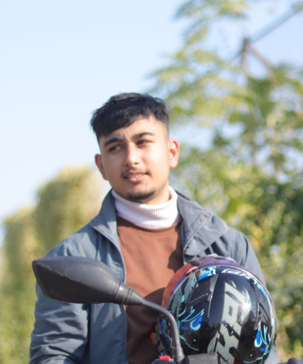
MEET OUR TEAM
OUR COMPANY TEAM
IOT/C/C++
QA/ Research
Frontend Dev.
Python Dev.
Saiman Pokharel
Prajjwal Adhikari
Utsav Wagle
Gaurav Dulal
LORA GPS TRACKER

